Slide 1
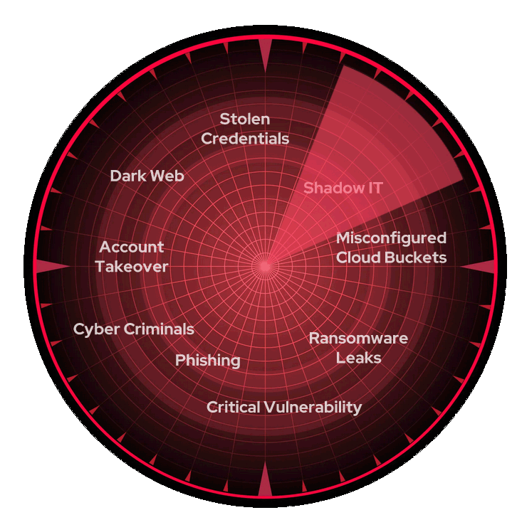
Cyber Security

Slide 2


Cyber Security
Cybersecurity is about protecting digital systems, networks, and data from unauthorized access, theft, or damage.
It's a critical and rapidly evolving field that ensures the confidentiality, integrity, and availability of information in our increasingly connected world.
It includes various technologies, processes, and practices designed to safeguard digital information and ensure confidentiality, integrity, and availability.
BM

Slide 3

Key terms in Cybersecurity
1
Confidentiality
2
Integrity
Ensuring that sensitive information is accessible only to authorized individuals or entities.
Maintaining the accuracy, completeness, and reliability of data throughout its entire lifecycle.
3
Availability
Ensuring that authorized users have reliable and timely access to information and resources when needed.

Slide 4
Scope of Cybersecurity
Infrastructure
Data
Applications
Protecting critical systems, networks, and digital assets from threats such as unauthorized access, DDoS attacks, and system failures.
Safeguarding sensitive information, including personal, financial, and intellectual property, from theft, corruption, or unauthorized disclosure.
Ensuring the security of software, web applications, and mobile apps to prevent vulnerabilities, malware, and other threats.

Slide 5
Top Cybersecurity topics
Network Security
Cloud Security
Protecting the integrity and availability of communication networks, including firewalls, VPNs, and intrusion detection systems.
Securing data and applications hosted in cloud computing environments, such as access controls, encryption, and compliance.
Incident Response
Risk Management
Preparing for, detecting, and effectively responding to cybersecurity incidents to minimize the impact and ensure business continuity.
Identifying, assessing, and mitigating potential cybersecurity risks to the organization's assets, operations, and reputation.
Endpoint security
Securing individual devices such as computers, laptops, smartphones, and tablets from cybersecurity threats, typically through antivirus software, encryption, and endpoint detection and response (EDR) systems.

Slide 6
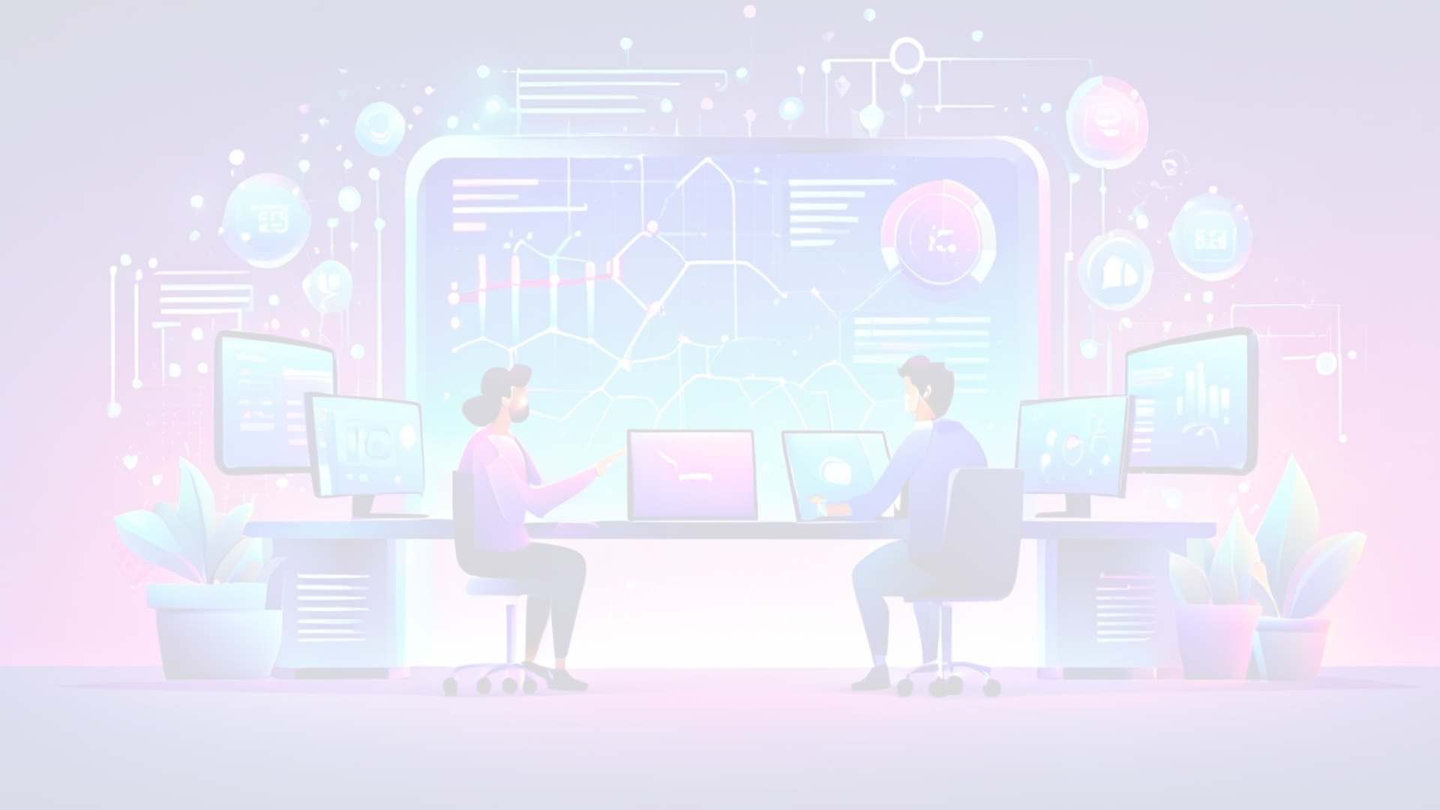
Importance of Cybersecurity
Data Protection
Compliance and Regulations
Safeguarding sensitive information, such as personal, financial, and intellectual property, from unauthorized access, theft, or misuse.
Meeting industry-specific and government-mandated cybersecurity standards and guidelines to avoid legal and financial penalties.
1
2
3
Business Continuity
Ensuring that an organization can continue its operations and maintain its competitiveness in the face of cyber threats.

Slide 7




Cybersecurity Risks
Data Breaches
Malware Infections
Targeted Attacks
Service Disruptions
Unauthorized access to sensitive information, leading to financial losses, reputational damage, and legal consequences.
Malicious software that can disrupt operations, steal data, or hold systems for ransom.
Sophisticated, persistent threats aimed at specific organizations or individuals, often for financial or political gain.
Denial-of-service attacks or system failures that can impact an organization's ability to operate effectively.
Notes:
Data breaches
The 773 Million Record "Collection #1" Data Breach
https://www.troyhunt.com/the-773-million-record-collection-1-data-reach/
https://www.troyhunt.com/telegram-combolists-and-361m-email-addresses/
https://www.bleepingcomputer.com/news/security/533-million-facebook-users-phone-numbers-leaked-on-hacker-forum/
https://socradar.io/top-5-underground-hacker-forums-that-are-accessible-via-your-web-browsers-such-as-google-chrome-firefox-and-internet-explorer/
Cloud storage comparison
https://www.techradar.com/best/best-free-cloud-storage-service
Test accounts
wndaula@mak.ac.ug
https://haveibeenbreached.com
https://haveibeenpwned.com/
https://dehashed.com
Exploits
https://www.cvedetails.com
https://www.exploit-db.com/search
Google hacking
https://www.exploit-db.com/google-hacking-database

Slide 8



Consequences of Ignoring Cybersecurity
Financial Losses
Reputational Damage
Operational Disruption
Costs associated with incident response, regulatory fines, and lost revenue due to disrupted operations.
Erosion of customer trust and brand reputation, leading to decreased market share and competitiveness.
Downtime, loss of productivity, and potential long-term impact on an organization's ability to function.

Slide 9
Embracing Cybersecurity
Proactive Approach
Implementing robust security controls and continuously monitoring for threats to stay ahead of cybercriminals.
Employee Training
Educating staff on cybersecurity best practices and fostering a culture of security awareness.
Incident Preparedness
Developing comprehensive incident response plans to effectively detect, respond, and recover from cyber attacks.
Emerging Technologies
Leveraging advanced technologies like AI, machine learning, and cloud-based security solutions to enhance protection.

